Slide 1
Coffee Shop Manager
CTRL_ALT_ELITE
Group 9

Slide 2
Introduction
Quick recap of project purpose
Progress since Demo 2
Overview of Demo 3 deliverables

Slide 3
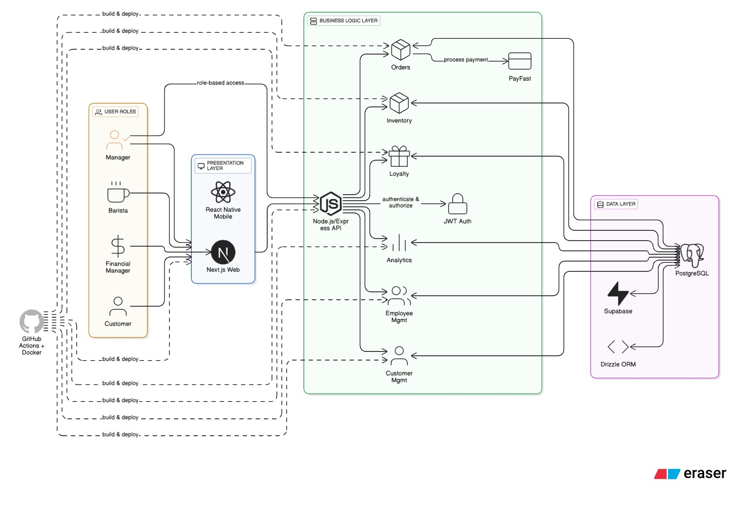
Architectural Diagram

Slide 4
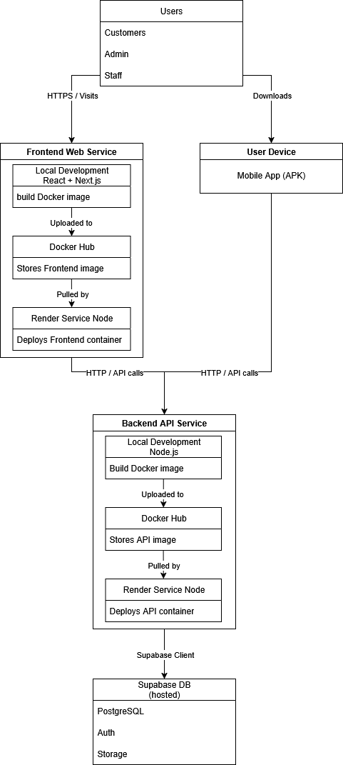
Deployment model

Slide 5
Live System Demo

Slide 6
Individual Contributions

Slide 7
Testing
Unit Testing
Integration and E2E Testing
Test coverage %

Slide 8
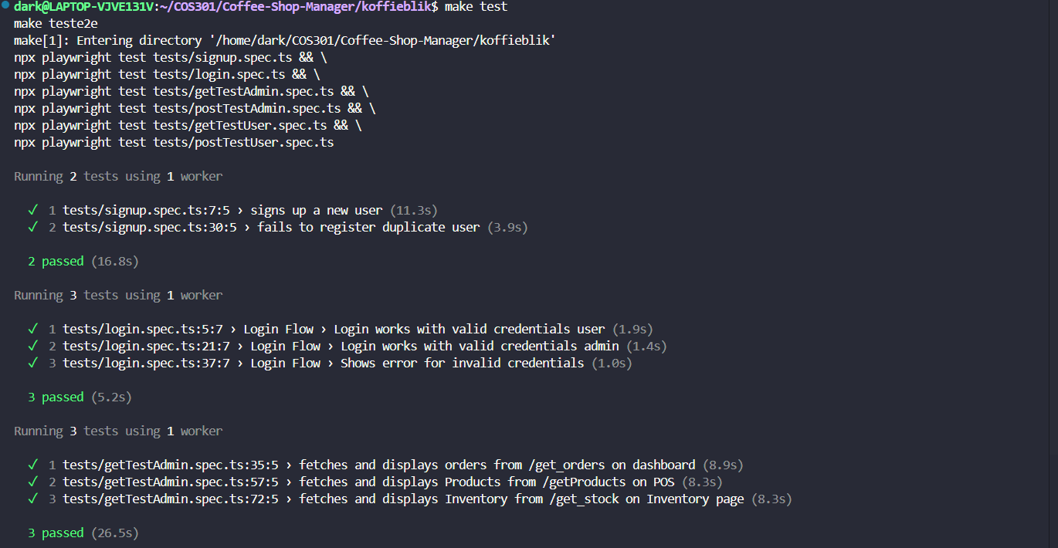
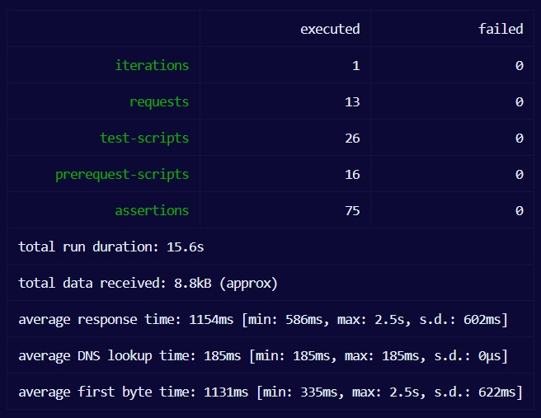
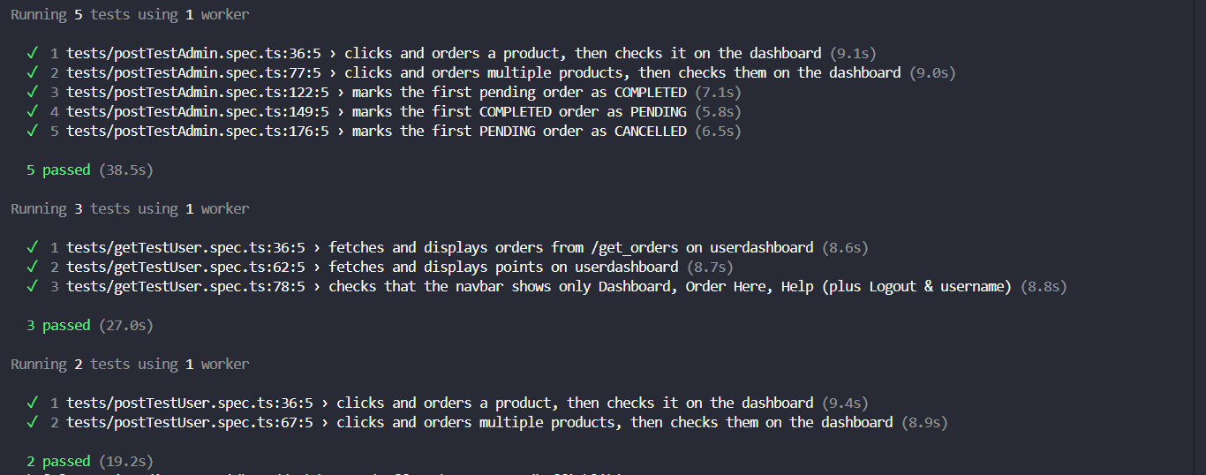

Slide 9
GitHub & CI/CD
Repo structure (monorepo)
Badges
CI/CD pipeline

Slide 10
Documentation Highlights
SRS updates
Domain model & Use Cases
Coding standards, user manual

Slide 11
Q&A

